Slide 1
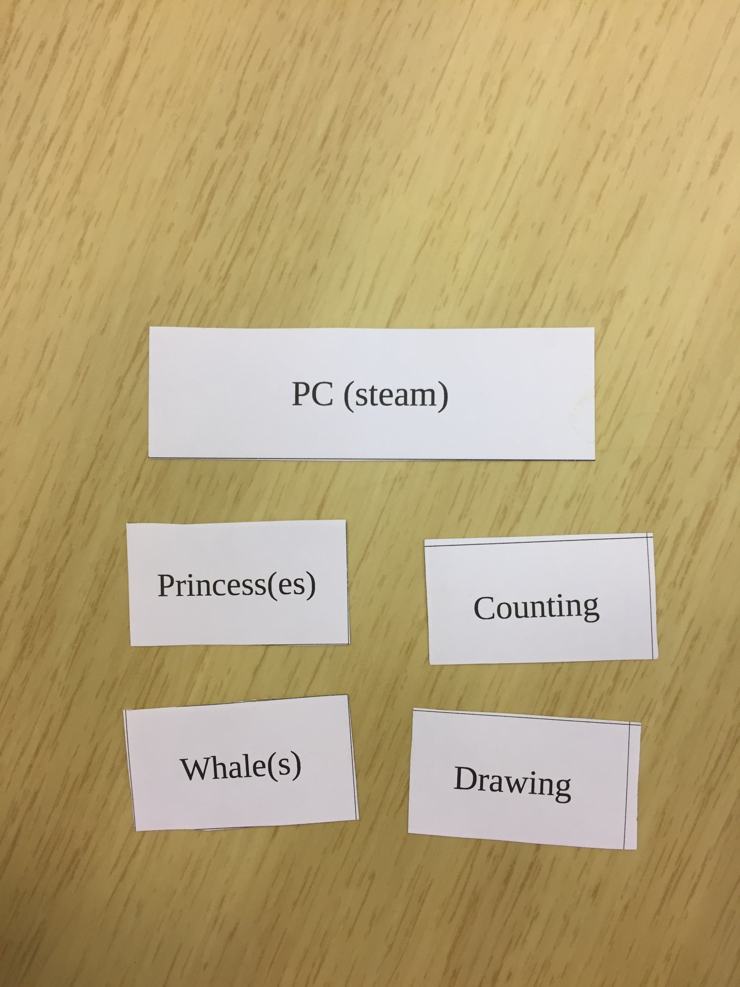
BOMB FISH
By Julien LUINO and Gautier JOUSSET

Slide 2
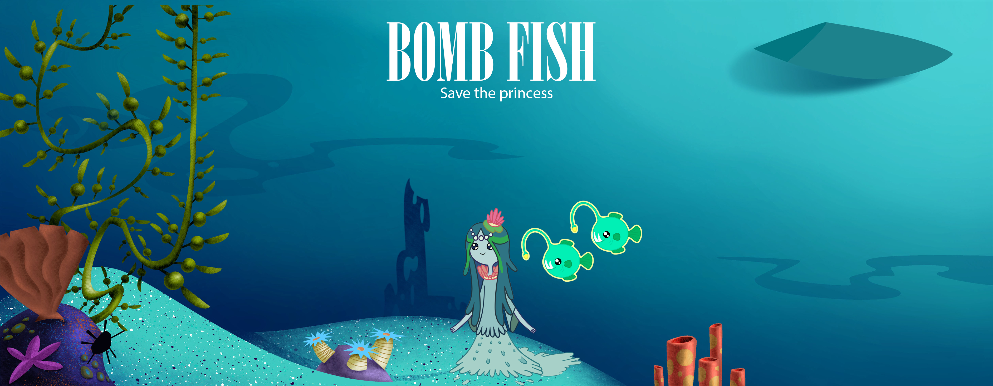
An 2d game based on drawing

Slide 3
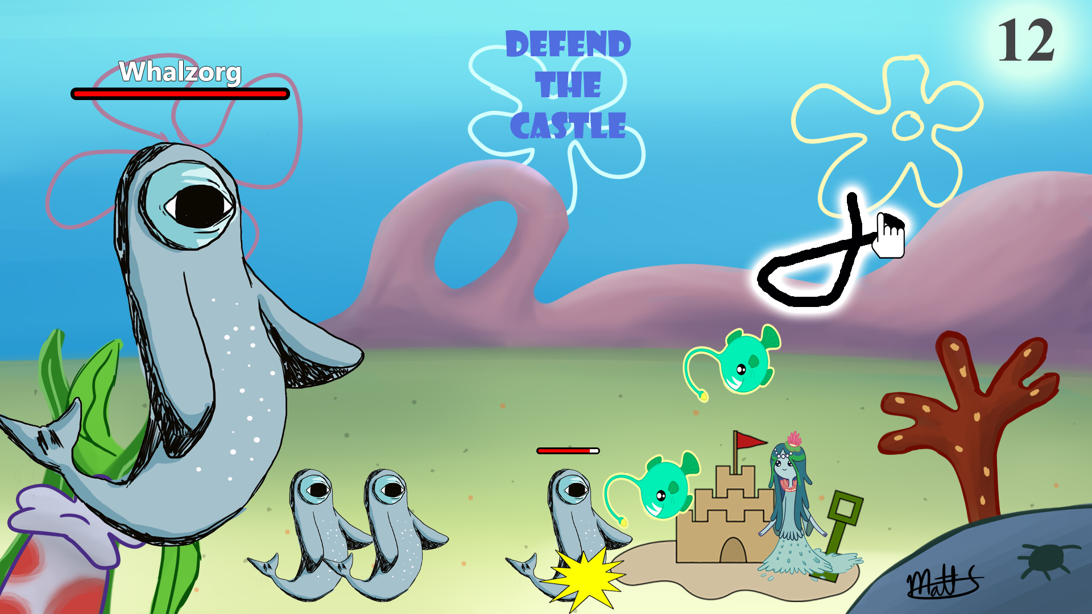
Destroy your enemies with your finger

Slide 4






Gameplay
-3 points
-5 points
Free

Slide 5

STEAM, a powerfull platform to promote your game
2,99€

Slide 6
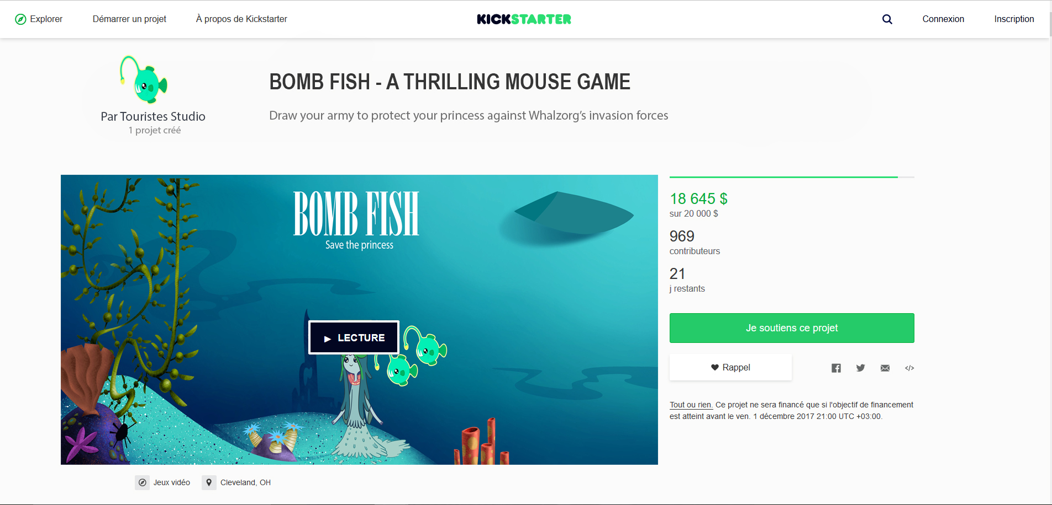
Help us on Kickstarter

Slide 7
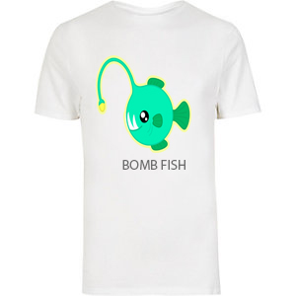
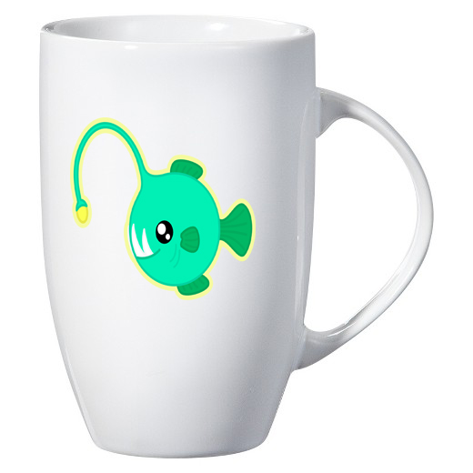
For donators

Slide 8
Questions ?

